Slide 1

ICU Admissions: Predictive Analysis of COVID-19 Patients
By Angelica butler

Slide 2

Agenda
Pandemic Overview
ICU Challenges
Sirio Labenes Study
Predictive Analysis
Conclusion

Slide 3
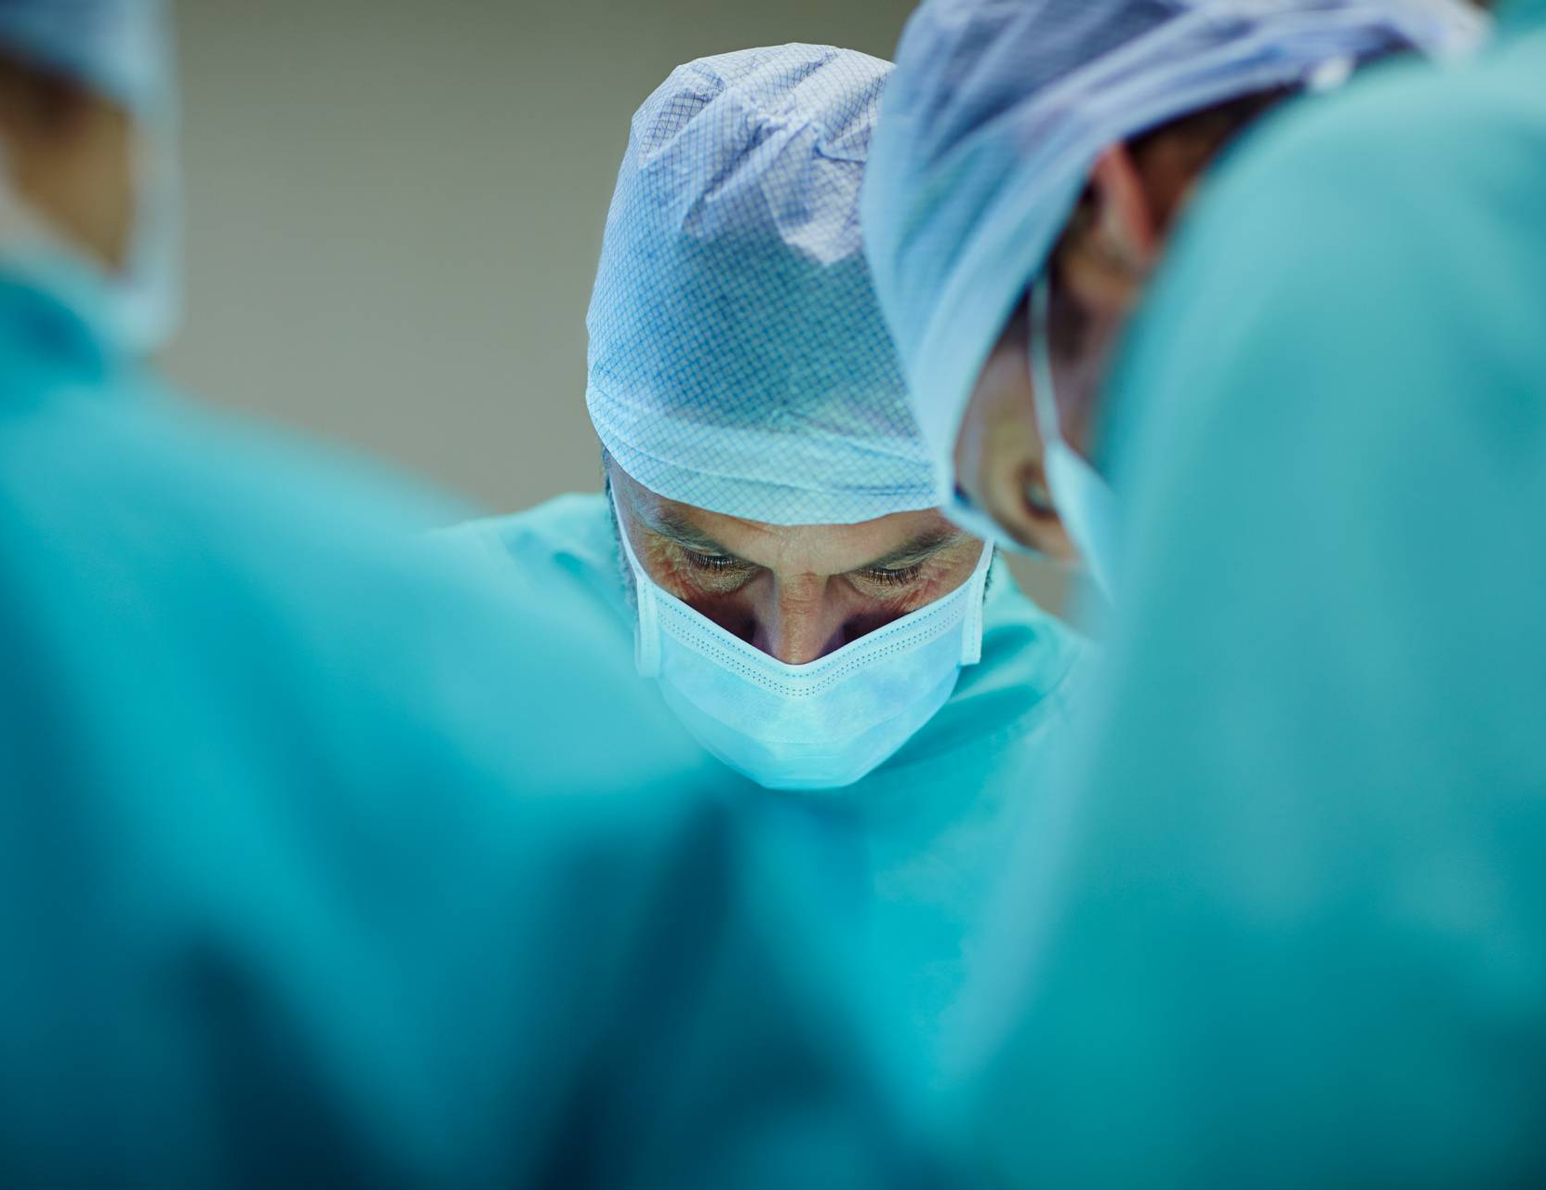
Impact of the COVID-19 Pandemic
The COVID-19 pandemic has had a profound impact on healthcare systems worldwide. Healthcare workers face unprecedented pressure and challenges as they navigate the chaos of the crisis. Key factors contributing to the strain include:
ICU Bed Availability
Access to Personal Protective Equipment (PPE)
Staffing and Personnel Shortages
Overall Healthcare Resource Constraints

Slide 4
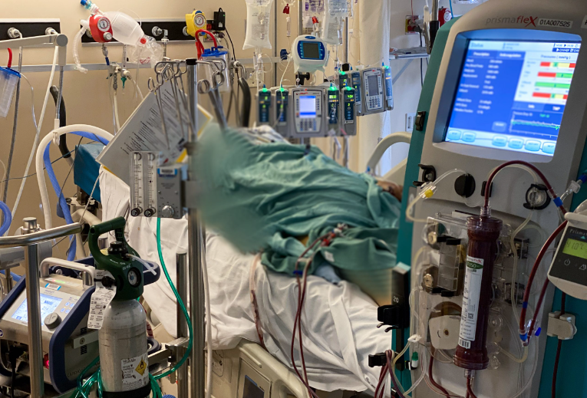
INTENSIVE CARE Unit (icu) Admission challenges’
Covid-19 is considered the greatest challenge in the history of critical care.
Identifying the requirement of intensive care among COVID-19 patients, can varies and take time when relaying on manual analysis.
Lost of resources can be wasted on patients that are ultimately not identified as critical care due to the time it task to distinguish from those who do.
Delays in identifying patients who need critical care can increase mortality rates.

Slide 5

Sirio Labanes study
Data from COVID-19 patients was gathered from Sirio Labenes and used in our analysis.
There was a total of 383 patients and the data that was gathered included the following variables:
Demographic Information
Previous Diseases
Blood Results
Vital Signs
Blood Gases

Slide 6
Objective of the study
The study aims to develop a predictive model that identifies COVID-19 patients who are likely to require ICU admission sooner in their treatment.

Slide 7
patients CARE outcome
There was a roughly 51% of a patient being admitted into ICU.

Slide 8
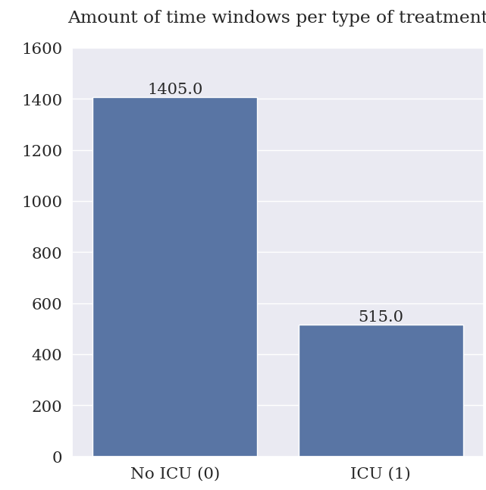
In this chart you can distinguished the time window where the patients that was admitted into ICU.
In most industries especially healthcare, time alone is a very expensive and important resource.

Slide 9
In this graph it shows which age group is primarily more high risk of becoming an ICU patients.

Slide 10

The help Critical care NEEDS
Identifying whether a patient needs to be admitted to the ICU sooner is key to alleviating many of the challenges critical care faces.
A predictive analysis was performed using machine learning algorithms called Random Forest based on the data study.
The model's sole purpose is to predict whether a patient should be admitted into the ICU. The model parameters are curated to perform this analysis more effectively and efficiently than any manual analysis could.

Slide 11
86%
The final model achieved an accuracy score of 86%. This means the model can predict which patients will require ICU admissions with 86% accuracy.

Slide 12
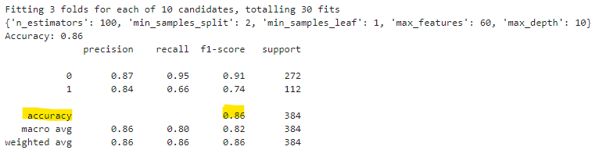
Model Attributes
The model was able to decipher between useful data and data that is not as important when deciding if a patient needs to be admitted into the ICU. Below is a high-level overview of the optimization efforts that were used to build the model.

Slide 13

MODEL ADOPTATION
Benefits of implementing this model into our system
R educing Healthcare Cost: Incorrect admissions into ICU is expensive.
Improve patient Outcome: Patients will be able to receive timely and appropriate care
Optimizing Resource Allocation: Utilize limited resources in a more efficient way.
Enhancing Healthcare System: The model will help manage the overwhelming amount of data, reducing the burden on the database.

Slide 14
Conclusions
Random Forest provides a powerful tool to predict ICU admissions for COVID-19 patients.
Early identification helps in saving lives by enabling proactive critical care.
Predictive models can be integrated into hospital workflows to optimize healthcare delivery during pandemics and beyond.
Investment in the system implementation will return great rewards.

Slide 15

Questions

Slide 16
references
https://www.kaggle.com/datasets/S%C3%ADrio-Libanes/covid19
https://www.ncbi.nlm.nih.gov/pmc/articles/PMC10692846/
https://www.ncbi.nlm.nih.gov/pmc/articles/PMC7780877/

